Slide 1
MyBatis Introduction

Slide 2
Related Projects
MyBatis 3
MyBatis-Spring
MyBatis-Velocity

Slide 3
Contents
1. Configuration
2. Spring Autowired
3. TypeHandler
4. Interceptor
5. Logging

Slide 4
Contents
6. Global ResultMap/Global SQL
7. Mapper Method
8. Discriminator
9. Cache

Slide 5
1. Configuration
mybatis-config.xml
SqlSessionFactoryBean

Slide 6
mybatis-config.xml
properties
typeAliases
plugins
objectFactory
objectWrapperFactory
settings
environments
databaseIdProvider
typeHandlers
mappers

Slide 7
mybatis-config.xml
settings
autoMappingBehavior: PARTIAL
cacheEnabled: true
localCacheScope: SESSION
proxyFactory: JavassistProxyFactory
lazyLoadingEnabled: false
aggressiveLazyLoading: true
multipleResultSetsEnabled: true
useColumnLabel: true
useGeneratedKeys: false
defaultExecutorType: SIMPLE
defaultStatementTimeout: no limit
safeRowBoundsEnabled: false
mapUnderscoreToCamelCase: false
jdbcTypeForNull: OTHER
safeResultHandlerEnabled: true
defaultScriptingLanguage: XMLLanguageDriver
callSettersOnNulls: false
logPrefix
logImpl: search in class path
lazyLoadTriggerMethods: equals,clone,hashCode,toString

Slide 8
SqlSessionFactoryBean
<bean id=“sqlSessionFactory" class="org.mybatis.spring.SqlSessionFactoryBean">
<property name="dataSource" ref="dataSource"/>
<property name="configurationProperties" ref="properties"/>
<property name="plugins" ref="plugins"/>
<property name="typeAliasesPackage" value="my.domain"/>
<property name="typeAliasesSuperType" value=“my.domain.Domain"/>
<property name="typeHandlersPackage" value="my.mybatis"/>
<property name="mapperLocations" value="classpath*:my/mapper/*.xml"/>
<property name="configLocation" value="classpath:mybatis-config.xml"/>
</bean>
Notes:
1. typeAliasesPackage,typeHandlersPackage是逗号、分号、TAB分隔的字符串数组
2. mapperLocations的类型是Resouce[]
3. 通过mybatis-config.xml能配置的，在这里基本也能配置，settings除外
4. typeAliasesSuperType只有在这里能配置

Slide 9
2. Spring Autowired
Difference
mapperLocations & Mapper Interface
<mappers>
2 Ways：
MyBatis custom tag: <scan>
Bean: MapperScannerConfigurer
Notes:
两种方式最终实现是一样的，就是扫描basePackage包里的相关Mapper接口，然后实例化代理类并注册到Spring容器中。然后，我们就可以根据Mapper接口进行注入了。

Slide 10
MyBatis custom tag: <scan>
<?xml version="1.0" encoding="UTF-8"?>
<beans xmlns="http://www.springframework.org/schema/beans"
xmlns:xsi="http://www.w3.org/2001/XMLSchema-instance"
xmlns:mybatis="http://mybatis.org/schema/mybatis-spring"
xsi:schemaLocation="http://www.springframework.org/schema/beans
http://www.springframework.org/schema/beans/spring-beans.xsd
http://mybatis.org/schema/mybatis-spring
http://mybatis.org/schema/mybatis-spring.xsd">
<mybatis:scan base-package=“org.test.mapper”/>
</beans>

Slide 11
Bean: MapperScannerConfigurer
<?xml version="1.0" encoding="UTF-8"?>
<beans xmlns="http://www.springframework.org/schema/beans"
xmlns:xsi="http://www.w3.org/2001/XMLSchema-instance"
xsi:schemaLocation="http://www.springframework.org/schema/beans
http://www.springframework.org/schema/beans/spring-beans.xsd">
<bean class="org.mybatis.spring.mapper.MapperScannerConfigurer">
<property name="basePackage" value=“org.test.mapper"/>
<property name="sqlSessionFactoryBeanName" value="sqlSessionFactory"/>
</bean>
</beans>

Slide 12
3. TypeHandler
MyBatis Type Aliases
MyBatis TypeHandlers
Custom TypeHandlers

Slide 13
MyBatis Type Aliases
_byte,_short,_int,_integer,_long,_double,_float, _boolean,byte,short,int,integer,long,double,float, boolean
_byte[],_short[],_int[],_integer[],_long[],_double[], _float[],_boolean[],byte[],short[],int[],integer[], long[],double[],float[], boolean[]
date,decimal,bigdecimal,biginteger,object, date[],decimal[],bigdecimal[],biginteger[],object[]
string,hashmap,map,list,arraylist,collection, iterator,ResultSet

Slide 14
MyBatis TypeHandlers
Custom TypeHandlers
implements TypeHandler<T>
extends BaseTypeHandler<T>

Slide 15
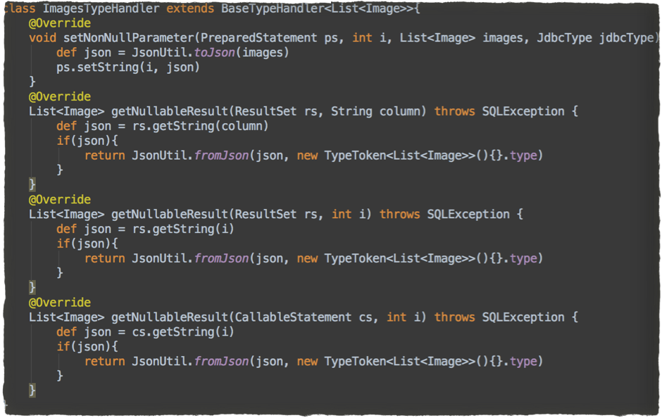

Slide 16
TypeHandlers
how MyBatis choose which type handler it should use with the column/property

Slide 17
4. Interceptor
4 types:
Executor
StatementHandler
ParameterHandler
ResultSetHandler
implementation
configuration

Slide 18
5. Logging
Supported logging frameworks:
SLF4J
Apache Commons Logging
Log4j 2
Log4j
JDK logging
Auto find in classpath
Configure in code

Slide 19
Configure in code
org.apache.ibatis.logging.LogFactory.useSlf4jLogging();
org.apache.ibatis.logging.LogFactory.useLog4JLogging();
org.apache.ibatis.logging.LogFactory.useJdkLogging();
org.apache.ibatis.logging.LogFactory.useCommonsLogging();
org.apache.ibatis.logging.LogFactory.useStdOutLogging();

Slide 20
6. Global ResultMap / Global SQL
every mapper has a namespace
locate with namespace
<… resultMap=“namespace.MyResultMap” …/>
<select …> <include refid=“namespace.mysql”/> … </select>

Slide 21
7. Mapper Method
Special parameters: RowBounds, ResultHandler
@Param Annotation
with
without
mixed
Example
Notes:
最多只能有一个RowBounds，一个ResultHandler
如果接受ResultHandler参数，返回数据类型必须为void，否则无效

Slide 22
Example
List select(
RowBounds rowBounds, // at most 1
@Param(‘xcid’) long xcid, // #{xcid}
int siteId, // #{param2}, #{1}
@Param(‘limit’) int limit, // #{limit}
int domestic // #{param4}, #{3}
)

Slide 23
8. Discriminator
Java Polymorphism(not only)
Comparison
one table —> multi class
one class —> multi table

Slide 24
One Table —> Multi Class
<resultMap id="vehicleResult" type=“Vehicle">
<id property="id" column="id" />
<result property="vin" column=“vin"/>
<discriminator javaType="int" column=“vehicle_type">
<case value="1" resultType="Car">
<result property="doorCount" column="door_count" />
</case>
<case value="2" resultType="Truck">
<result property="boxSize" column="box_size" />
<result property="extendedCab" column="extended_cab" />
</case>
<case value="3" resultType="Van">
<result property="powerSlidingDoor" column="power_sliding_door" />
</case>
<case value="4" resultType="SUV">
<result property="allWheelDrive" column="all_wheel_drive" />
</case>
</discriminator>
</resultMap>

Slide 25
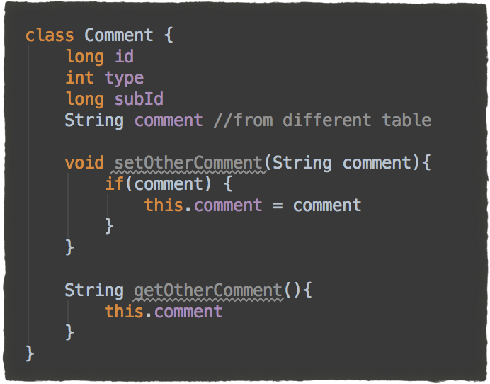
One Class —> Multi Table

Slide 26
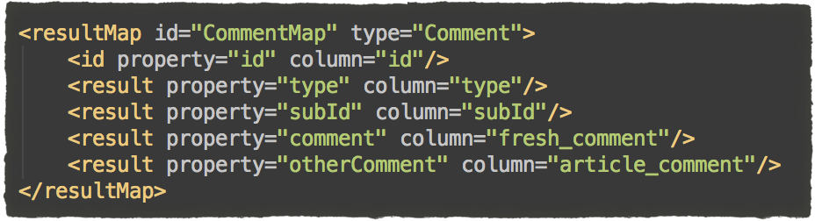
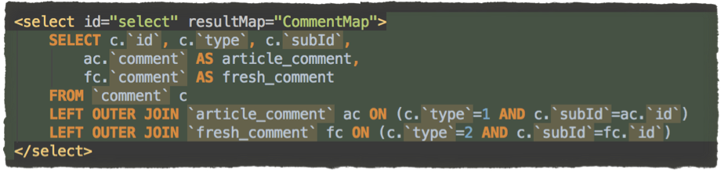
One Class —> Multi Table

Slide 27
9. Cache
local cache & second level cache
setting: cacheEnabled(global)
<cache> <cache-ref>
local cache scope:
STATEMENT
SESSION

Slide 28
Thanks

